Slide 1
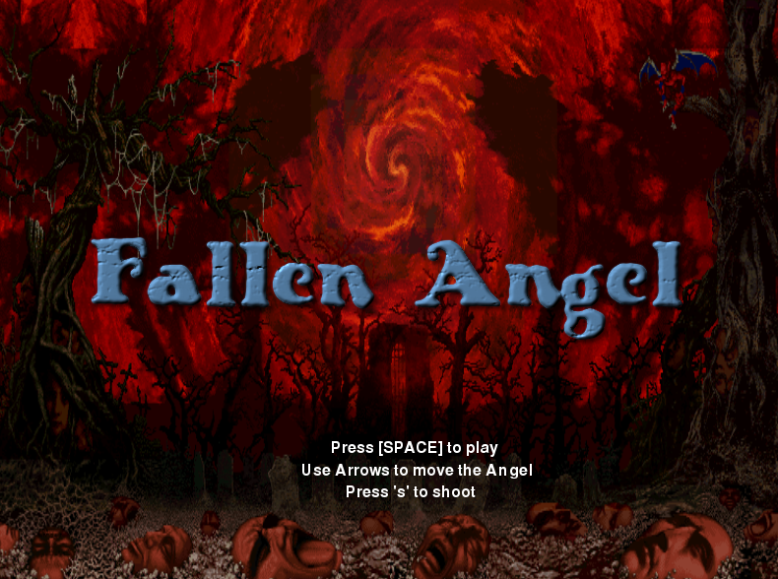
AFTERLIFE ARTS
BY: ARSH & CHRISTINA
Notes:
An angel falls down from heaven and lands on Earth. The angel is imprisoned by demons. . The objective of the game is to survive and get back home to heaven before getting dragged down to hell. Collect the souls, shoot demons, and find diamond to get back to heaven.

Slide 2
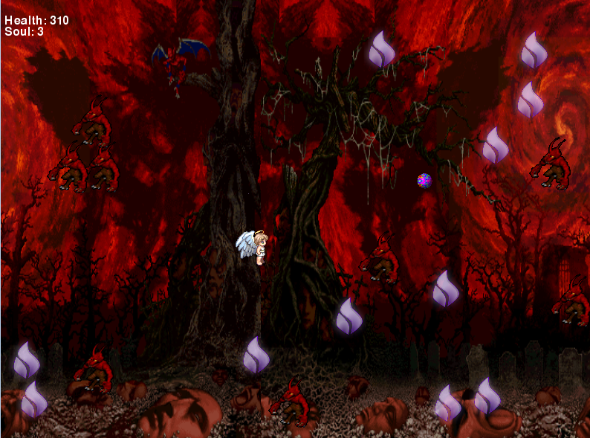
Notes:
Collect soul
Shoot/dogdge demon (with ball)
Press s to shoot

Slide 3
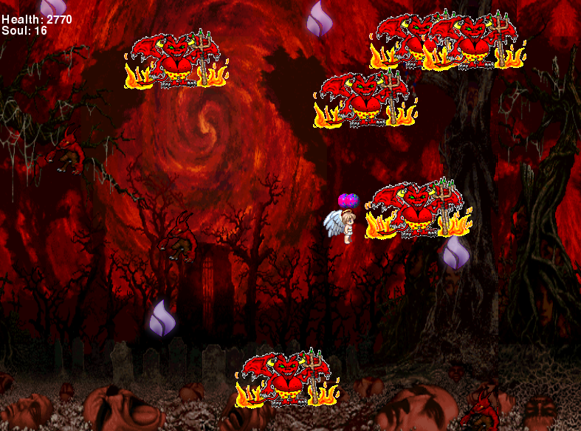
Notes:
These are the devils which is bigger and stronger. More health.

Slide 4
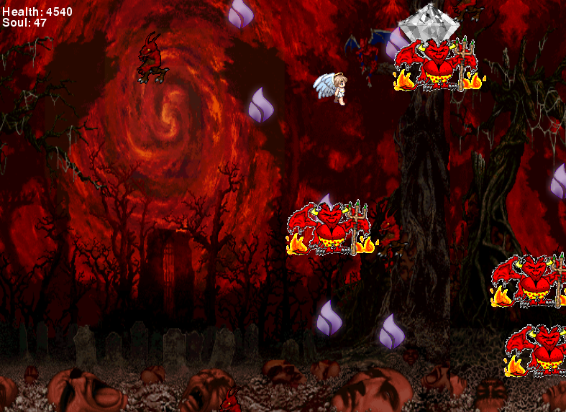
Notes:
That’s the diamond. You have to collect it to win the game.
If you die you lose.

